Slide 1
Finding a Needle in a Haystack: Facebook’s Photo Storage
Original work by Beaver, et al. Presented by Tim Calloway

Slide 2
Roadmap
Problem Description
Background and Previous Design
Current Design
Evaluation and Performance
Conclusion
Discussion

Slide 3
Problem Description
Facebook stores over 260 billion images
20 PB of data
Users upload one billion new images each week
60 TB of data
Facebook serves over one million images per second at peak
Two types of workloads for image serving
Profile pictures – heavy access, smaller size
Photo albums – intermittent access, higher at beginning, decreasing over time (long tail)

Slide 4
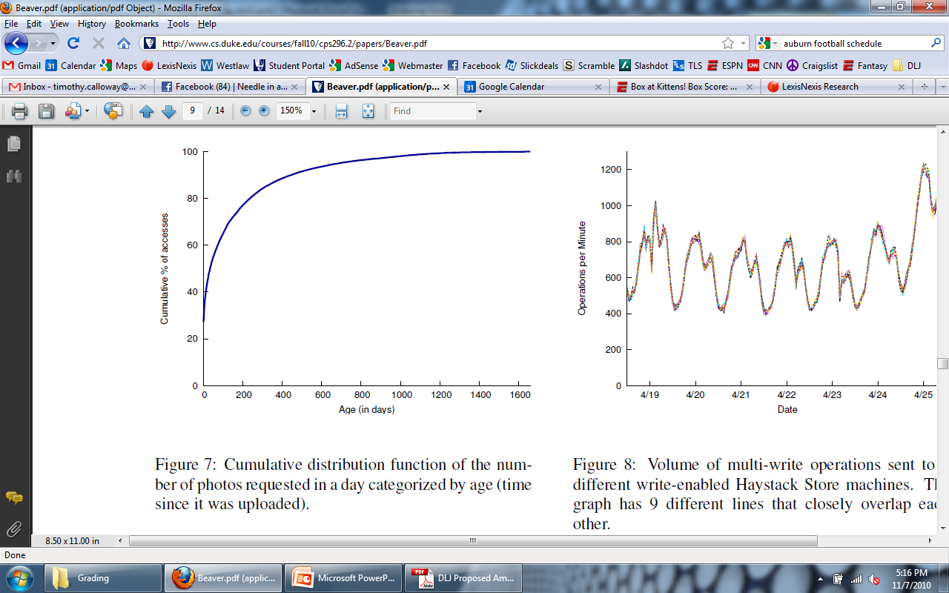
Long Tail Issue

Slide 5
Problem Description
Four main goals for photo serving method:
High throughput and low latency
Provide a good user experience
Fault-tolerant
Handle server crashes and hard drive failures
Cost-effective
Save money over traditional approaches (reduce reliance on CDNs!)
Simplicity
Make it easy to implement and maintain

Slide 6
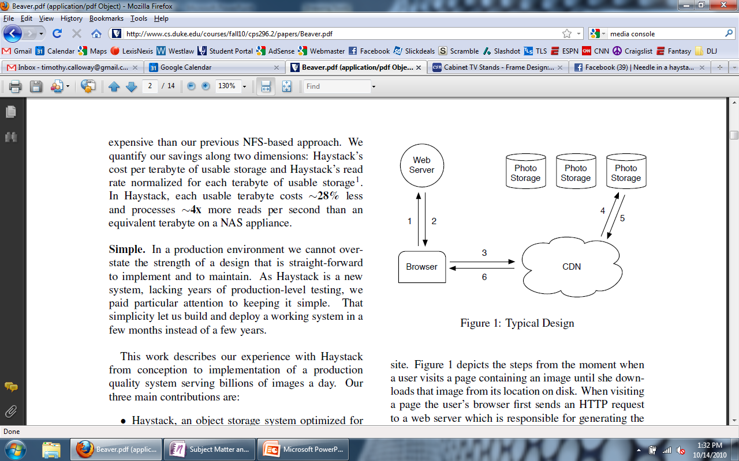
Typical Design

Slide 7
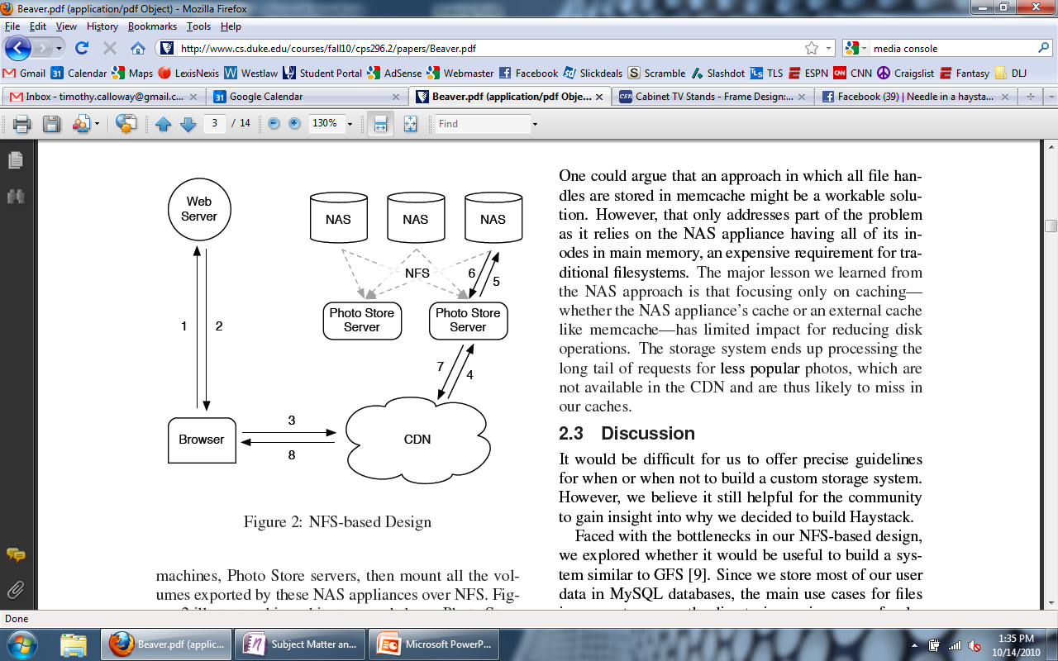
Facebook’s Old Design

Slide 8
Old Design
The old photo infrastructure consisted of several tiers:
Upload tier receives users’ photo uploads, scales the original images and saves them on the NFS storage tier.
Photo serving tier receives HTTP requests for photo images and serves them from the NFS storage tier.
NFS storage tier built on top of commercial storage appliances.

Slide 9
Features of Old Design
Since each image is stored in its own file, there is an enormous amount of metadata generated on the storage tier due to the namespace directories and file inodes.
The amount of metadata far exceeds the caching abilities of the NFS storage tier, resulting in multiple I/O operations per photo upload or read request
High degree of reliance on CDNs = expensive

Slide 10
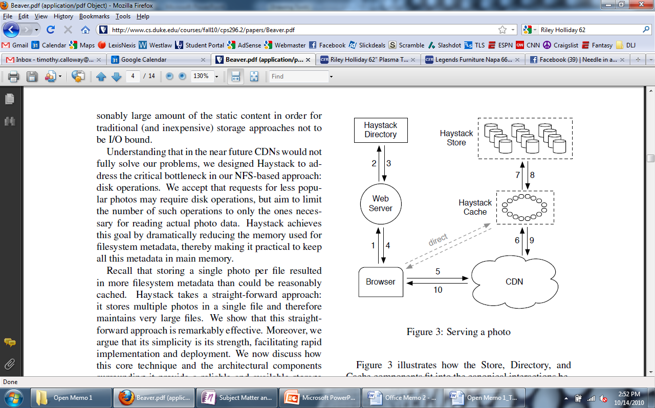
Enter Haystack

Slide 11
Step-through of Operation
User visits page
Web server receives the request
Uses Haystack Directory to construct URL for each photo
http://<CDN>/<Cache>/<Machine id>/<Logical volume, Photo>
From which CDN to request the photo
This portion may be omitted if the photo is available directly from the Cache
If CDN is unsuccessful, contacts the Cache

Slide 12
Haystack

Slide 13
Haystack Directory
Four main functions…
Provides a mapping from logical volumes to physical volumes
Load balances writes across logical volumes
Determines whether a photo request should be handled by the CDN or by the Haystack Cache
Identifies logical volumes that are read-only
Operational reasons
Reached storage capacity

Slide 14
Haystack

Slide 15
Haystack Cache
Distributed hash table, uses photo’s id to locate cached data
Receives HTTP requests from CDNs and browsers
If photo is in Cache, return the photo
If photo is not in Cache, fetches photo from the Haystack Store and returns the photo
Add a photo to Cache if two conditions are met…
The request comes directly from a browser, not the CDN
The photo is fetched from a write-enabled Store machine

Slide 16
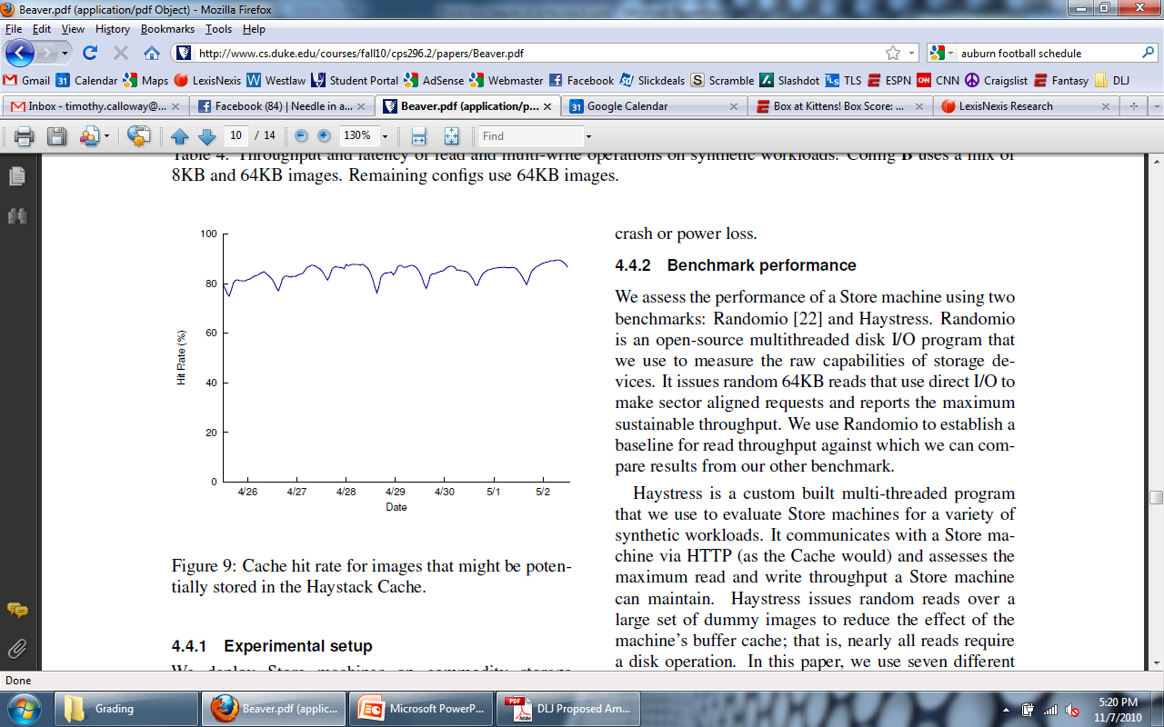
Cache Hit Rate

Slide 17
Haystack

Slide 18
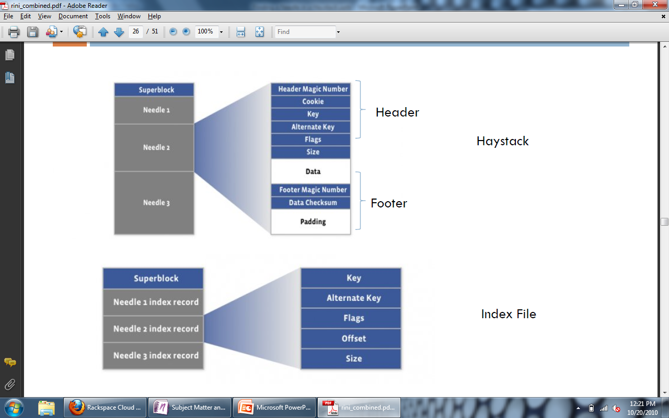
Haystack Object

Slide 19
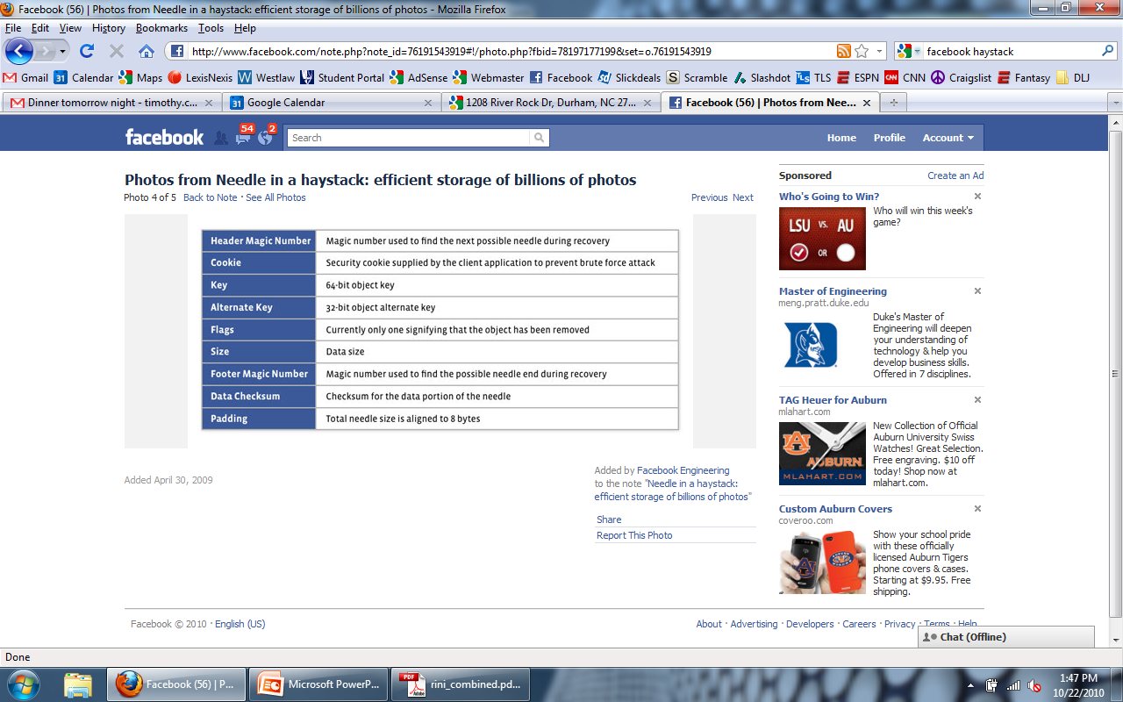
A Closer Look at the Needles…
A needle is uniquely identified by its <Offset, Key, Alternate Key, Cookie> tuple, where the offset is the needle offset in the haystack store.

Slide 20
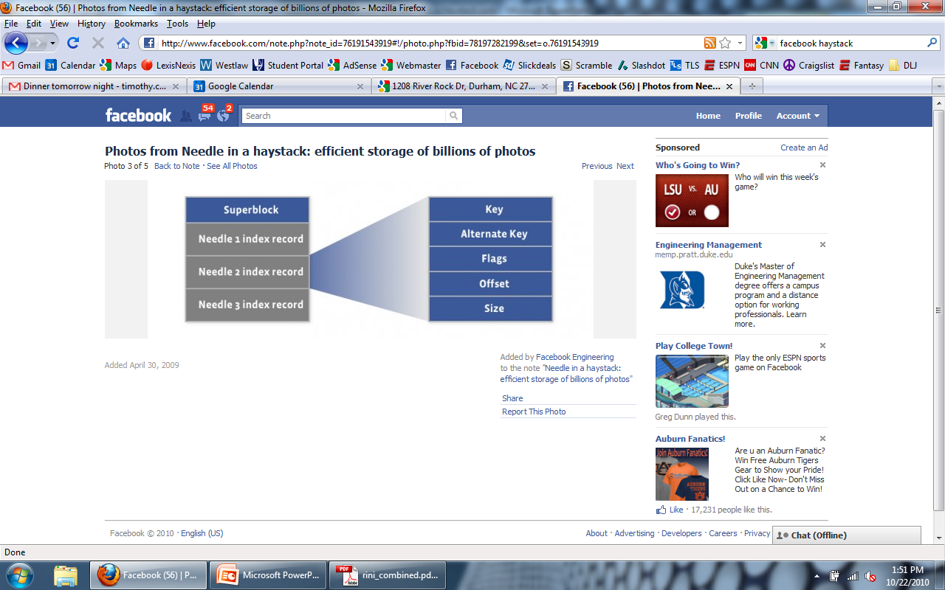
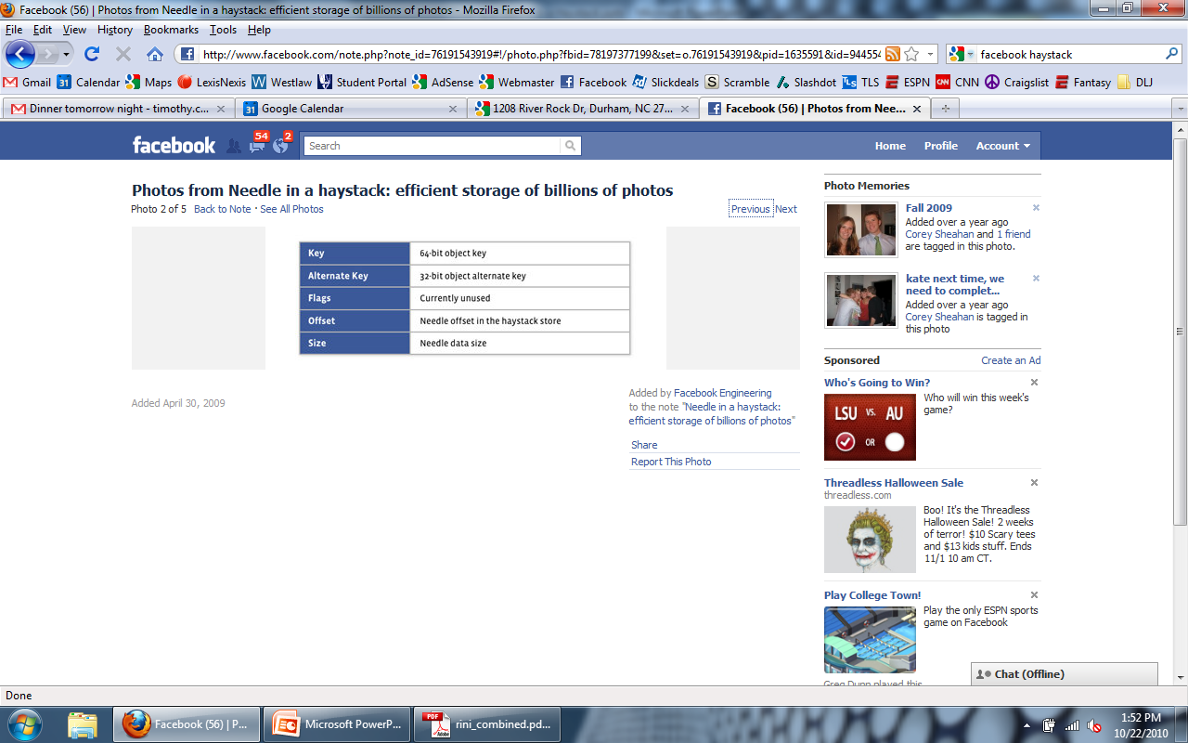
Haystack Index File

Slide 21
Haystack Index File
The index file provides the minimal metadata required to locate a particular needle in the store
Main purpose: allow quick loading of the needle metadata into memory without traversing the larger Haystack store file
Index is usually less than 1% the size of the store file

Slide 22
Haystack Store
Each Store machine manages multiple physical volumes
Can access a photo quickly using only the id of the corresponding logical volume and the file offset of the photo
Handles three types of requests…
Read
Write
Delete

Slide 23
Haystack Store Read
Cache machine supplies the logical volume id, key, alternate key, and cookie to the Store machine
Purpose of the cookie?
Store machine looks up the relevant metadata in its in-memory mappings
Seeks to the appropriate offset in the volume file, reads the entire needle
Verifies cookie and integrity of the data
Returns data to the Cache machine

Slide 24
Haystack Store Write
Web server provides logical volume id, key, alternate key, cookie, and data to Store machines
Store machines synchronously append needle images to physical volume files
Update in-memory mappings as needed

Slide 25
Haystack Store Delete
Store machine sets the delete flag in both the in-memory mapping and in the volume file
Space occupied by deleted needles is lost!
How to reclaim?
Compaction!
Important because 25% of photos get deleted in a given year.

Slide 26
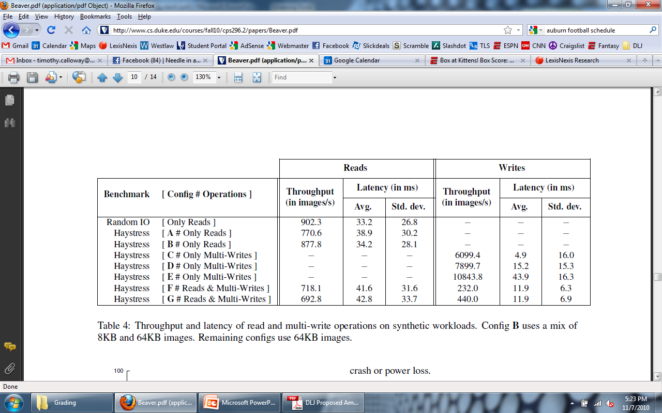
Experimental Data

Slide 27
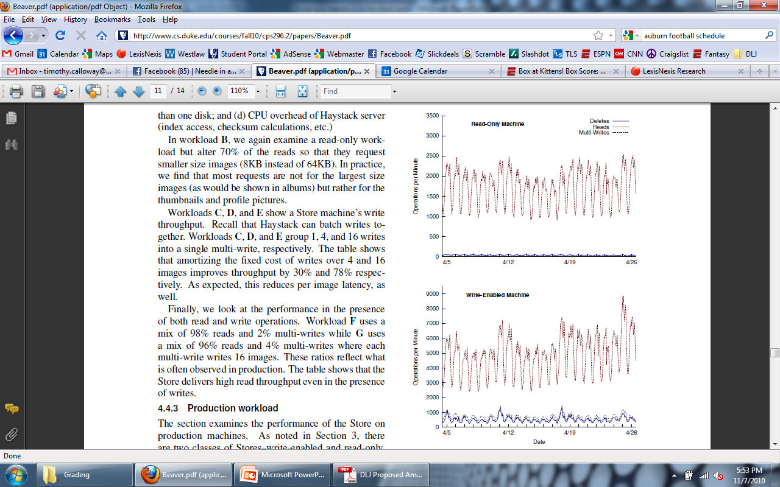
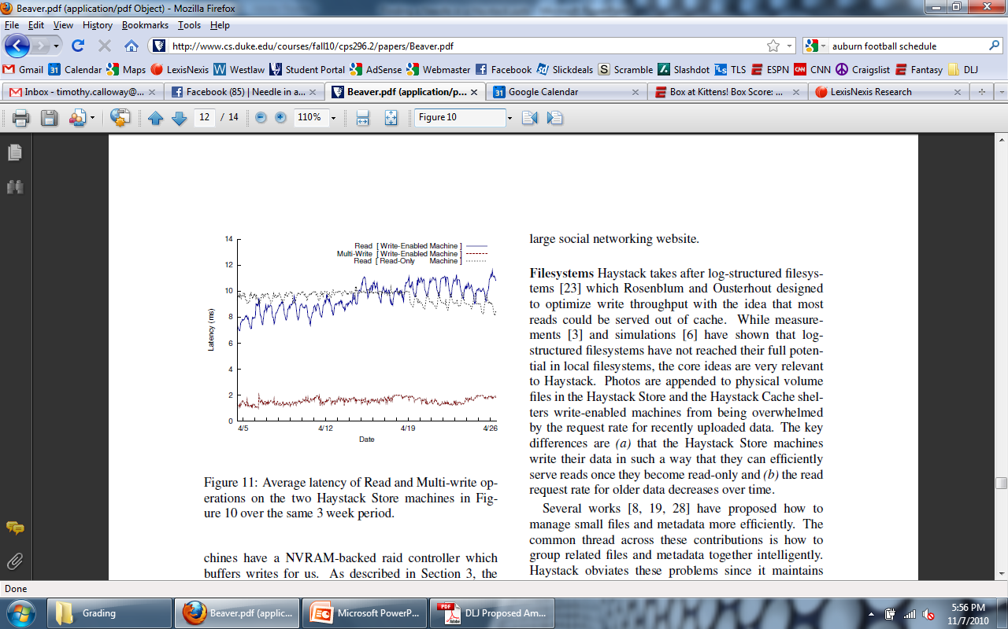
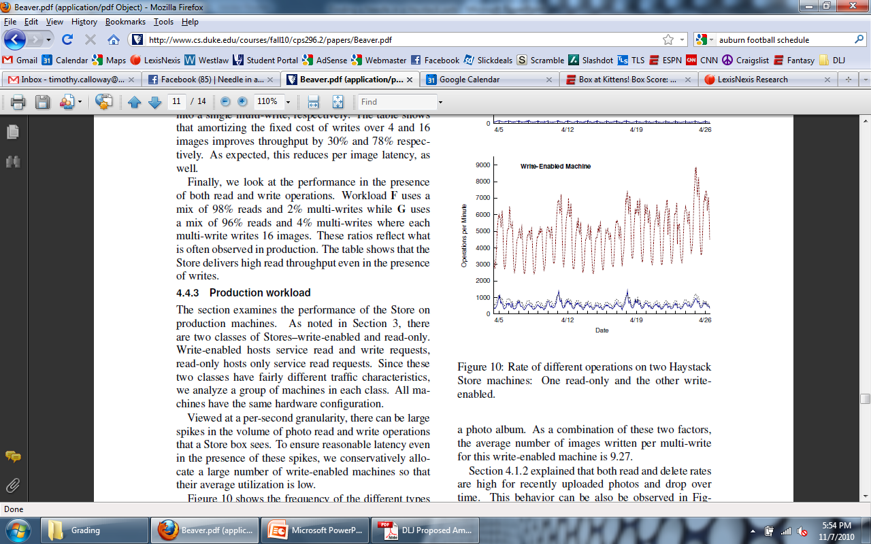
Production Data

Slide 28
Haystack Advantages
Reduced disk I/O
10 TB/node -> 10 GB of metadata
This amount is easily cacheable!
Simplified metadata
No directory structures/file names
64-bit ID
Results in easier lookups
Single photo serving and storage layer
Direct I/O path between client and storage
Results in higher bandwidth
Notes:
<number>

Slide 29
Discussion/Questions
Is compaction the best solution? Seems a bit expensive. Better ideas?
What about album level abstraction?
Important/better if photos from the same album are placed sequentially or at least close together?
Privacy concerns
Are cookies sufficient protection? Is there a better way?
What about security levels in Facebook? How are they enforced with respect to Haystack?
How is consistency maintained between the Haystack and the CDN?

